Slide 1
ATAI
Advanced Technique of Artificial Intelligence
Chongqing University of Technology
Semi-Supervised Text Classification via Self-Pretraining（WSDM2021）
Reported by TingWang
Github: https://github.com/p-karisani/self-pretraining

Slide 2
Catalog
一
Background
二
Innovation
三
Model
四
Experiment

Slide 3
一、 Background
Pre-trained:
self-training:
The increasingly negative impact of noisy pseudo-labels overshadows the benefit of incorporating unlabeled data.
Being unable to revise the pseudo-labels once they are assigned to the unlabeled documents and augmented with the set of labeled documents.

Slide 4
二、 Innovation
It is threshold-free, it can cope with the semantic drift problem, and can also revise the previously labeled documents. To our knowledge, Self-Pretraining is the first model that addresses these drawbacks in a unified framework.
We propose a novel learning rate schedule to effectively integrate the optimization procedure with our two-stage semi-supervised learning process.
we model the class distribution of the pseudo-labels as a stochastic process and propose a novel approach to transform the class distributions.

Slide 5
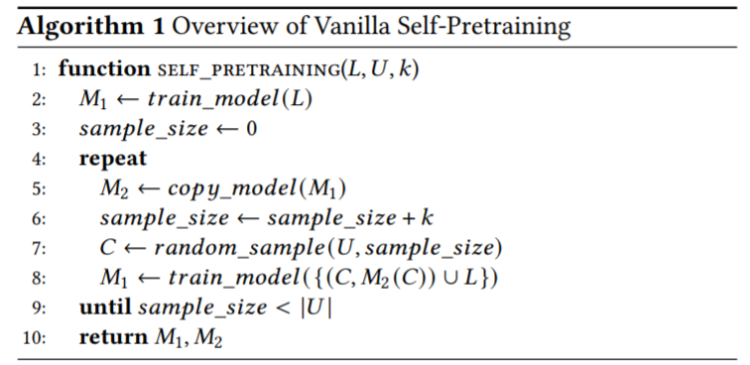
三、 Model

Slide 6
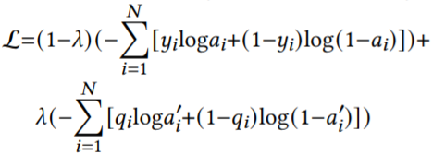
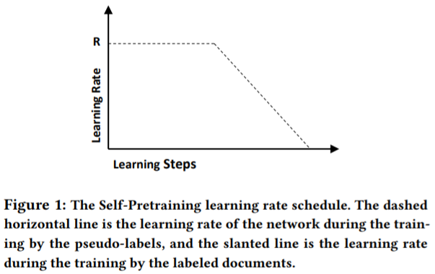
三、 Model
1.Hypothesis Transfer and Iterative Distillation
step 2、3
2. Two-Stage Semi-Supervised Learning
3. Right Trapezoidal Learning Rates
step 1
4. Inertial Class Distributions

Slide 7
四、 Experiment

Slide 8
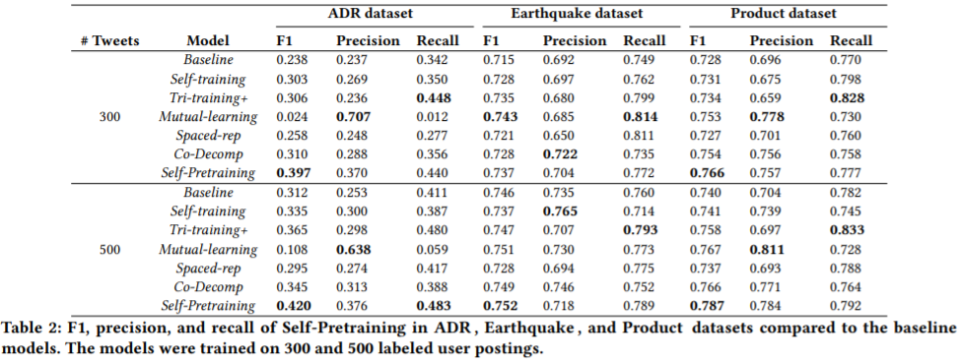
四、 Experiment

Slide 9
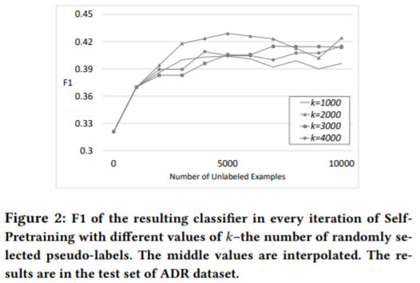
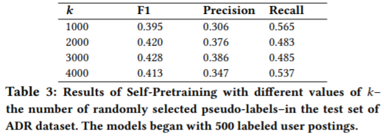
四、 Experiment

Slide 10
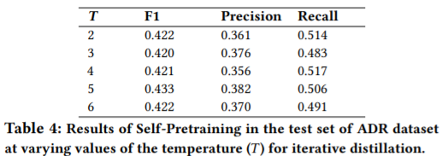
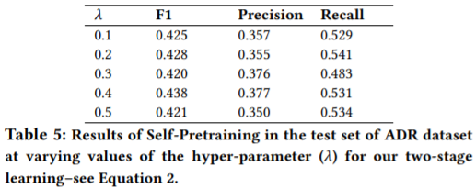
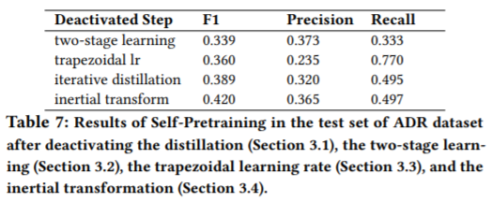
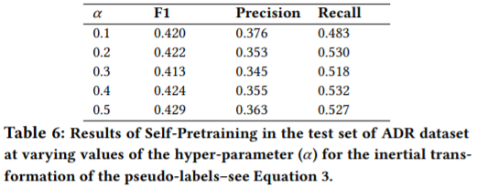
四、 Experiment

Slide 11
THANKS

